Slide 1
19CSE435: Computer Vision
Feature Detection and matching
Adopted from Computer Vision Textbook and course materials R_Szeliski

Slide 2
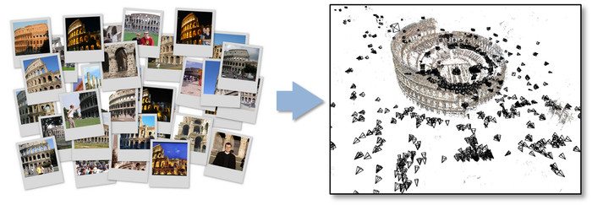
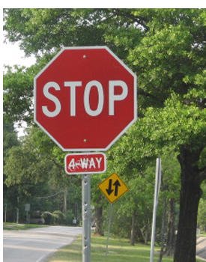


Introduction - Motivation
The Computer Vision (CV) algorithms require the detection and matching of the features
For example: image-alignment. It may be worthwhile to identify the points that align (that point the same things) in these two images and can be stitched together seamlessly
Another example is the image correspondence that can be established between two images so a 3D representation can be generated
it is important to identify (detect) what kind of features (points of similarity or correspondence in the above pictures) have to be identified and then matched
≈

Slide 3
Features
The features can be
a) key points, corners with respect to locations
b) edges
Key point features or interest points or corners
These features are specific to points or specific locations in the images (mountain peaks, building corners) and are described by the appearance of the pixels surrounding it i.e., patches.
Edges
These represent the edges in the image and can be matched by their orientation and local pixel appearance (edge profiles). These give a good estimate of the occlusions or image boundaries in the images. These can be grouped to curves, contours, straight lines and can be tracked. The vanishing points (Camera parameters can be evaluated by grouping the straight lines.)

Slide 4
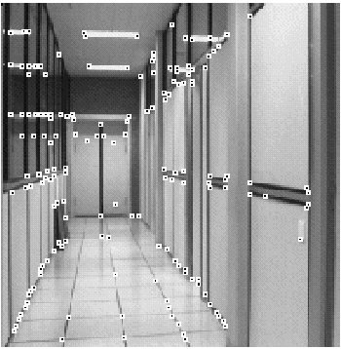
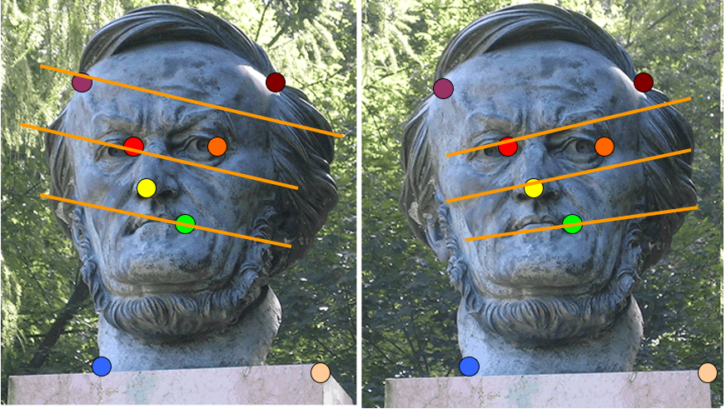
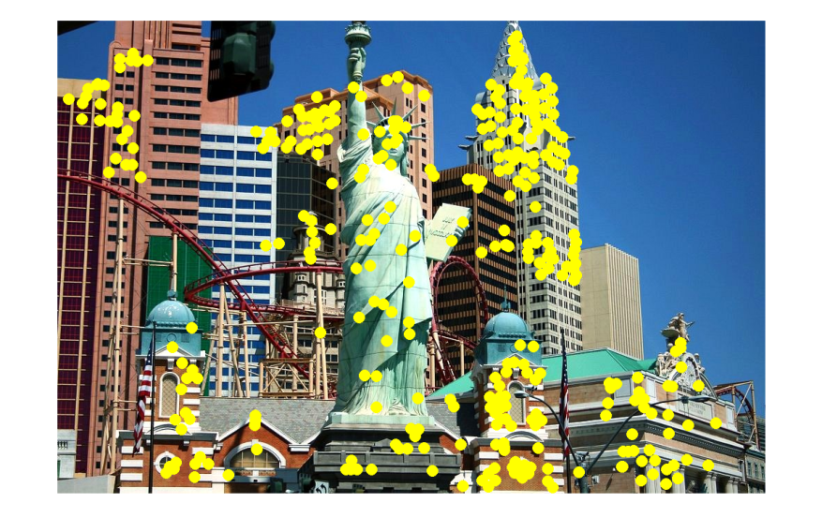
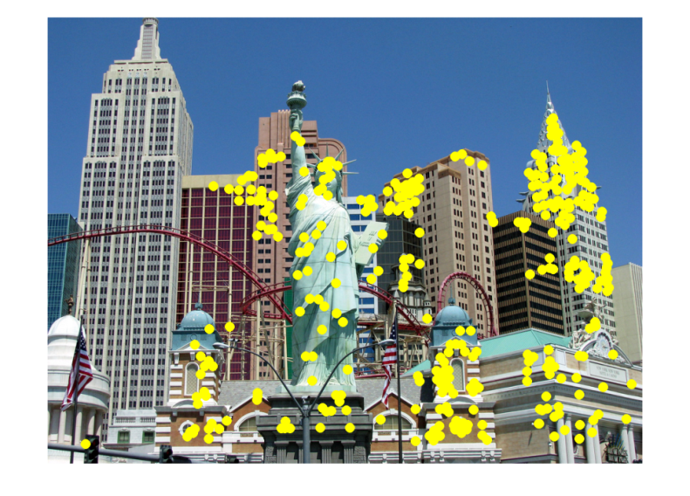
Applications
Feature points are used for
Image alignment
3D reconstruction
Motion tracking
Robot navigation
Indexing and database retrieval
Object recognition

Slide 5
Points, key points, corners
The point features provide a sparse representation of locations
- matching their locations in different images thereby estimating the camera poses
-preliminary level of correlation for dense stereo matching
-advantage is that these can be used in the case of clutter(occlusions) and orientation change
Two different ways of feature detection
→ Find the features in one image that can be tracked and then match it using local search techniques like correlation or lease squares (similarity) etc. This is suitable when the images are taken from a nearby view point or in short intervals or video
→ Find features in all images and then match them based on its local appearance. This is better for those where a large change is expected and applications like establishing correspondences in wide baseline stereo, object recognition etc

Slide 6
Key point detection
The feature detection can be further broken down into four stages as listed below
Feature detection (extraction) stage:
the images are searched for the locations that match well with all the images.
Feature description:
The detected key point location and the region around it is converted in to a more compact, stable (invariant) representation for better matching with other descriptors.
Feature matching:
Searches for the likely candidate matches of the descriptors in other images.
Feature tracking:
Searches only a small neighbourhood around the detected key point location and is more suitable for video
Detect points that are repeatable and distinctive

Slide 7
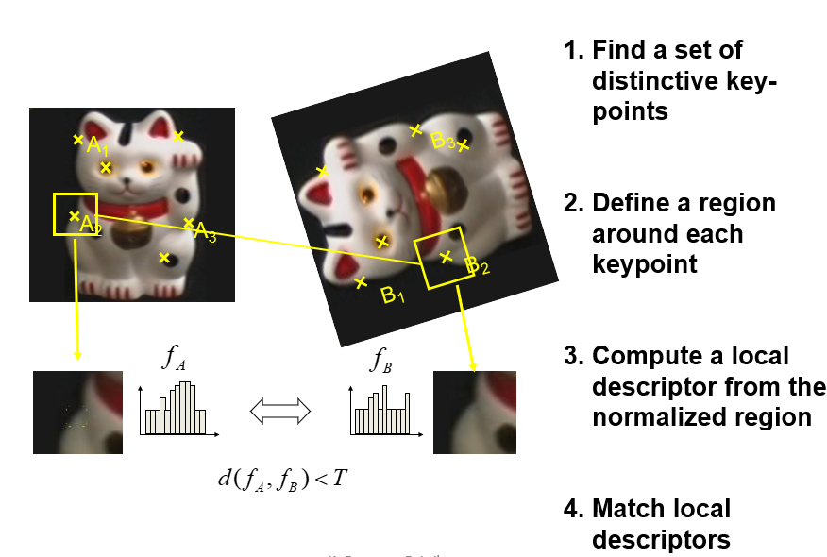
Key point detection

Slide 8


Characteristics of good features
Repeatability
The same feature can be found in several images despite geometric and photometric transformations
Saliency
Each feature is distinctive
Compactness and efficiency
Many fewer features than image pixels
Locality
A feature occupies a relatively small area of the image; robust to clutter and occlusion

Slide 9
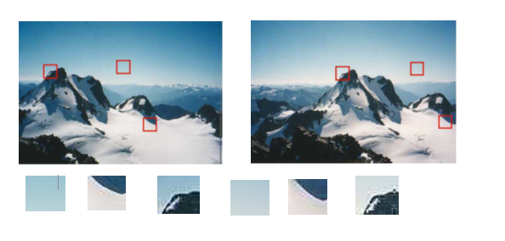
Feature detection
It is important identify the patches that can be matched well. Every part of the image can’t be tracked or matched easily.
parts of image without texture are hard to detect
the edges corners and boundaries with large contrast changes (gradients) can be localized easily

Slide 10

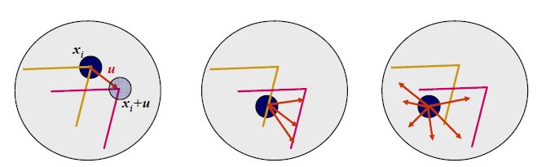
Aperture problem
The gif shows the aperture problem. The movement appears to be perpendicular to the straight line, however the true movement need not be in that direction
The three images below show the feature detection with respect to two images when they have overlaid on each other. The first image represents the stable movement represented by vector u. the second image represents the aperture problem and the third one represents the texture less features

Slide 11
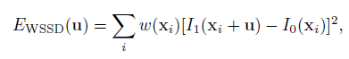
Feature Detection
The simplest matching criteria is the weighted sum of squared differences
Where w(x_{i}) is the weighting function, I₁ and I­₀ represent the two images and the u=(u,v) displacement vector.
It is not known which other locations of the image will be matched so this metric can be computed stable with respect to small variations in position Δu by comparing it with itself.

Slide 12
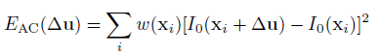
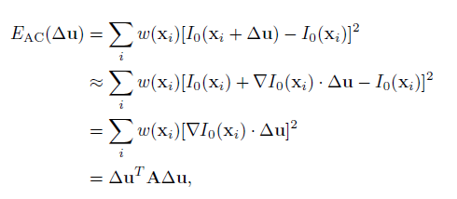
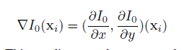
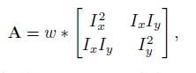
Feature Detection
For example in the image below three points, one on the flower bed , one on the roof and one on the cloud is selected. The corresponding definition of the autocorrelation and its evaluation is as listed
The grayscale images of the three points are shown along with the surface plots
The autocorrelation function can be written as

Slide 13
Many Existing Detectors Available
Hessian & Harris [Beaudet ‘78], [Harris ‘88]
Laplacian, DoG [Lindeberg ‘98], [Lowe 1999]
Harris-/Hessian-Laplace [Mikolajczyk & Schmid ‘01]
Harris-/Hessian-Affine [Mikolajczyk & Schmid ‘04]
EBR and IBR [Tuytelaars & Van Gool ‘04]
MSER [Matas ‘02]
Salient Regions [Kadir & Brady ‘01]
Others…

Slide 14

Corner Detection: Basic Idea
We should easily recognize the point by looking through a small window
Shifting a window in any direction should give a large change in intensity
“flat” region: no change in all directions
“edge”: no change along the edge direction
“corner”: significant change in all directions
Source: A. Efros

Slide 15
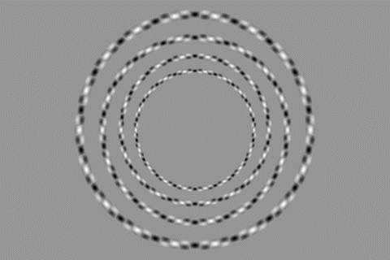

Slide 16
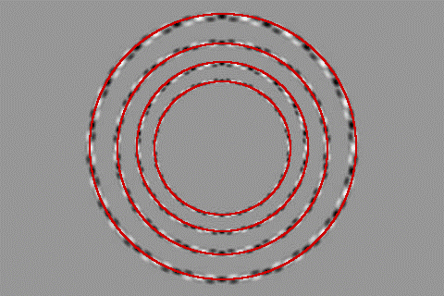

Slide 17
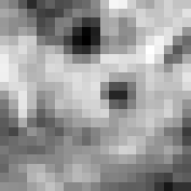

Corner Detection: Mathematics
Change in appearance of window w(x,y)
for the shift [u,v]:
I(x, y)
E(u, v)
E(3,2)
w(x, y)

Slide 18
Corner Detection: Mathematics
Change in appearance of window w(x,y)
for the shift [u,v]:
I(x, y)
E(u, v)
E(0,0)
w(x, y)

Slide 19
Corner Detection: Mathematics
Change in appearance of window w(x,y)
for the shift [u,v]:
Window function
Shifted intensity
Intensity
Window function w(x,y) =
or
1 in window, 0 outside
Gaussian
Source: R. Szeliski

Slide 20
Corner Detection: Mathematics
Change in appearance of window w(x,y)
for the shift [u,v]:
We want to find out how this function behaves for small shifts
E(u, v)

Slide 21
Corner Detection: Mathematics
Change in appearance of window w(x,y)
for the shift [u,v]:
We want to find out how this function behaves for small shifts
But this is very slow to compute naively.
O(window_width² * shift_range² * image_width²)
O( 11² * 11² * 600² ) = 5.2 billion of these
14.6 thousand per pixel in your image

Slide 22
Corner Detection: Mathematics
Change in appearance of window w(x,y)
for the shift [u,v]:
We want to find out how this function behaves for small shifts
Recall Taylor series expansion. A function f can be approximated around point a as

Slide 23
Corner Detection: Mathematics
Change in appearance of window w(x,y)
for the shift [u,v]:
We want to find out how this function behaves for small shifts
Local quadratic approximation of E(u,v) in the neighborhood of (0,0) is given by the second-order Taylor expansion:
Notes:
Technically a Maclaurin expansion, a special case of Taylor expansion centered at 0.
What is the point? Well, now we’re just extrapolating local measurements instead of doing 10s of thousands of computations.

Slide 24
Corner Detection: Mathematics
Local quadratic approximation of E(u,v) in the neighborhood of (0,0) is given by the second-order Taylor expansion:
E(u, v)
Always 0
First derivative is 0
Notes:
Technically a Maclaurin expansion, a special case of Taylor expansion centered at 0.

Slide 25
Corner Detection: Mathematics
The quadratic approximation simplifies to
where M is a second moment matrix / Auto correlation computed from image derivatives:
M

Slide 26
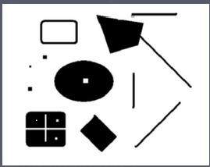
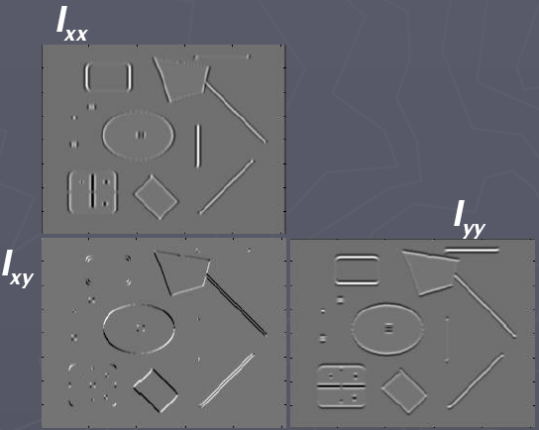
Corners as distinctive interest points
2 x 2 matrix of image derivatives (averaged in neighborhood of a point).
Notation:

Slide 27
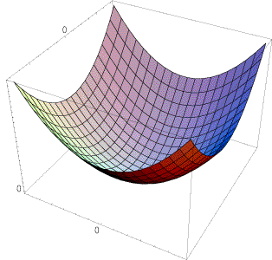
Interpreting the second moment matrix
The surface E(u,v) is locally approximated by a quadratic form. Let’s try to understand its shape.

Slide 28
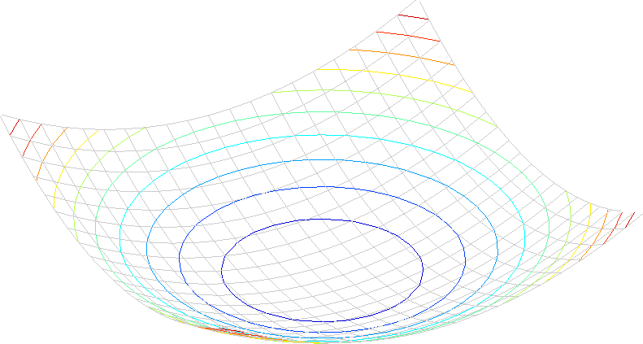
Interpreting the second moment matrix
Consider a horizontal “slice” of E(u, v):
This is the equation of an ellipse.

Slide 29
Interpreting the second moment matrix
First, consider the axis-aligned case (gradients are either horizontal or vertical)
If either λ is close to 0, then this is not a corner, so look for locations where both are large.

Slide 30
Interpreting the second moment matrix
Consider a horizontal “slice” of E(u, v):
This is the equation of an ellipse.
Diagonalization of M:
The axis lengths of the ellipse are determined by the eigenvalues and the orientation is determined by R
direction of the fastest change
direction of the slowest change
(λ_{max})^{-1/2}
(λ_{min})^{-1/2}

Slide 31
Interpreting the eigenvalues
Classification of image points using eigenvalues of M:
λ₂
“Edge” λ₂ >> λ₁
“Corner” λ₁ and λ₂ are large, λ₁ ~ λ₂; E increases in all directions
λ₁ and λ₂ are small; E is almost constant in all directions
“Flat” region
“Edge” λ₁ >> λ₂
λ₁

Slide 32
Corner response function
α: constant (0.04 to 0.06)
“Edge” R < 0
“Corner” R > 0
|R| small
“Flat” region
“Edge” R < 0

Slide 33
Harris corner detector
Compute M matrix for each image window to get their cornerness scores.
Find points whose surrounding window gave large corner response (f> threshold)
Take the points of local maxima, i.e., perform non-maximum suppression
C.Harris and M.Stephens. “A Combined Corner and Edge Detector.” Proceedings of the 4th Alvey Vision Conference: pages 147—151, 1988.
Notes:
33

Slide 34
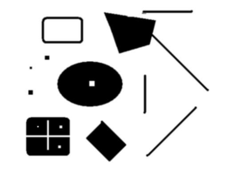
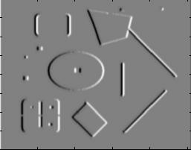
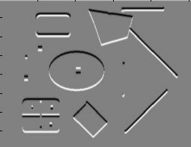
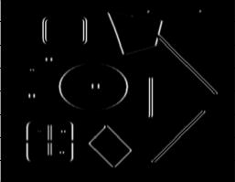
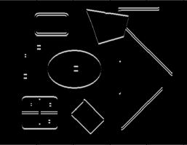
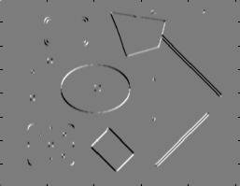
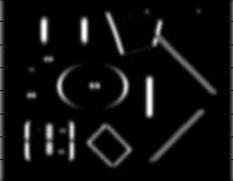
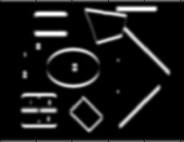
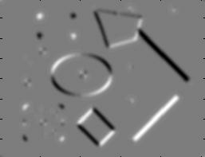
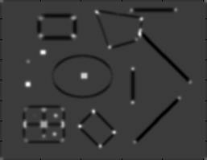
Harris Detector [Harris88]
Second moment matrix
1. Image derivatives
I_{x}
I_{y}
(optionally, blur first)
I_{x}²
I_{y}²
I_{x}I_{y}
2. Square of derivatives
3. Gaussian filter g(σ_{I})
g(I_{x}²)
g(I_{y}²)
g(I_{x}I_{y})
4. Cornerness function – both eigenvalues are strong
5. Non-maxima suppression
har

Slide 35

Harris Detector: Steps

Slide 36

Harris Detector: Steps
Compute corner response R

Slide 37

Harris Detector: Steps
Find points with large corner response: R>threshold

Slide 38

Harris Detector: Steps
Take only the points of local maxima of R

Slide 39

Harris Detector: Steps

Slide 40
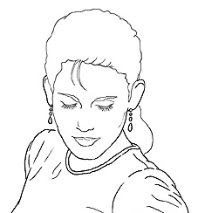
Edge Detection
Goal: map image from 2d array of pixels to a set of curves or line segments or contours.
Why?
Main idea: look for strong gradients, post-process

Slide 41
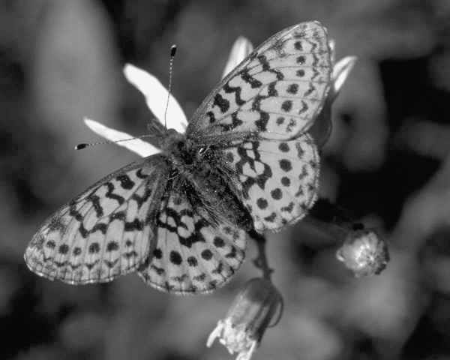
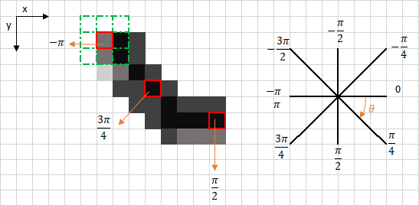
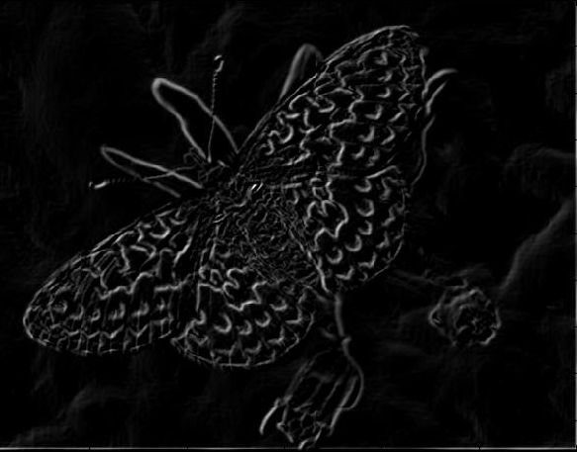
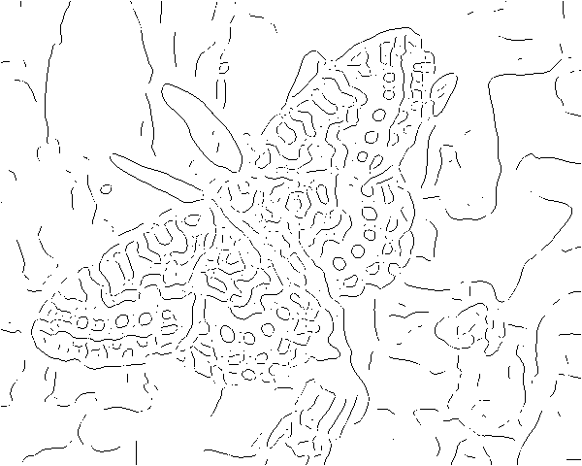
Gradients → edges
Primary edge detection steps:
1. Smoothing: suppress noise
2. Edge enhancement: filter for contrast
3. Edge localization
Determine which local maxima from filter output are actually edges vs. noise
Threshold, Thin
Choose a threshold value t
Set any pixels less than t to zero (off)
Set any pixels greater than or equal to t to one (on)
Slide credit: Kristen Grauman

Slide 42
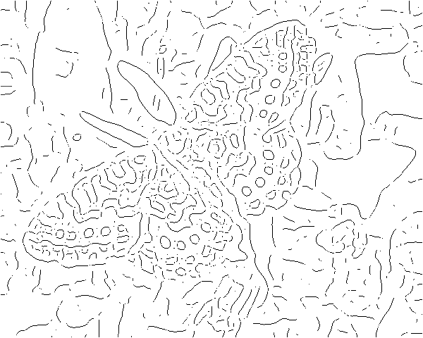
Thresholding
Original image
Gradient magnitude
Low threshold image
High threshold image

Slide 43
Canny edge detector
Filter image with derivative of Gaussian
Find magnitude and orientation of gradient
Non-maximum suppression:
Thin wide “ridges” down to single pixel width
Linking and thresholding (hysteresis):
Define two thresholds: low and high
Use the high threshold to start edge curves and the low threshold to continue them
Slide credit: David Lowe, Fei-Fei Li

Slide 44

The Canny edge detector
original image (Lena)
Slide credit: Steve Seitz

Slide 45
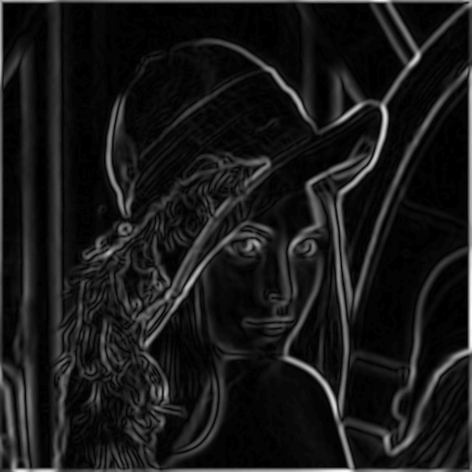
The Canny edge detector
norm of the gradient
Slide credit: Kristen Grauman

Slide 46
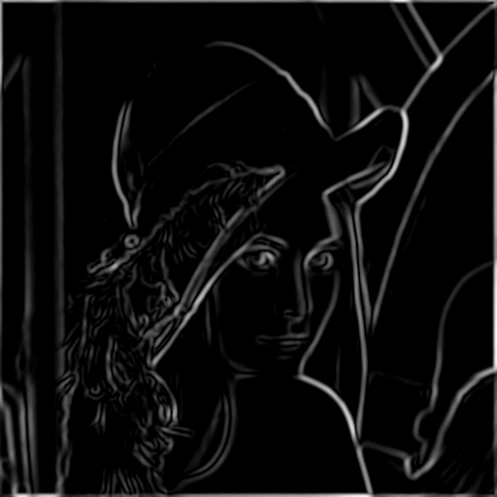
The Canny edge detector
thresholding
Slide credit: Kristen Grauman

Slide 47
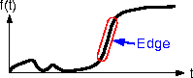
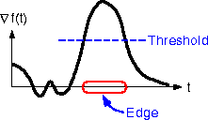
The Canny edge detector
How to turn these thick regions of the gradient into curves?
thresholding
Slide credit: Kristen Grauman

Slide 48

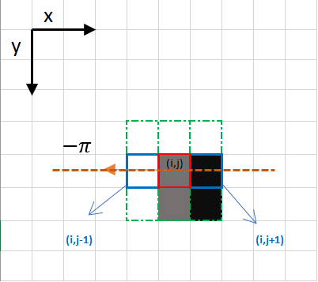
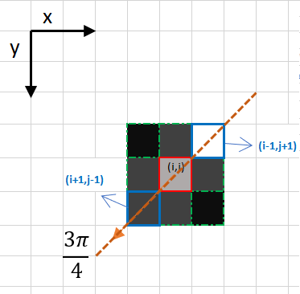
Non-maximum suppression
Check if pixel is local maximum along gradient direction
Select single max across width of the edge
Requires checking interpolated pixels p and r
Slide credit: Kristen Grauman

Slide 49
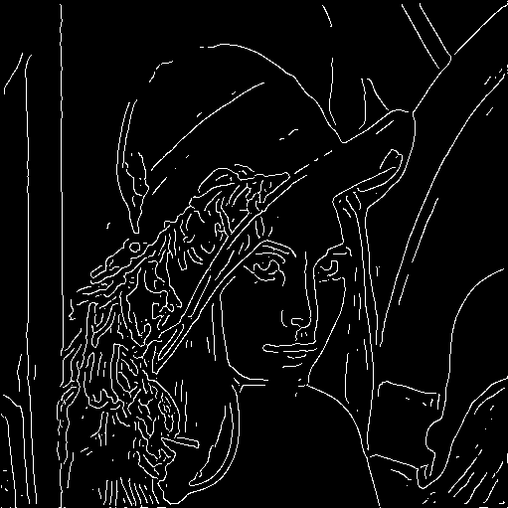
The Canny edge detector
Problem: pixels along this edge didn’t survive the thresholding
thinning
(non-maximum suppression)
Slide credit: Kristen Grauman

Slide 50
Hysteresis thresholding
Use a high threshold to start edge curves, and a low threshold to continue them.
Slide credit: Steve Seitz

Slide 51
Hysteresis thresholding
original image
high threshold
(strong edges)
low threshold
(weak edges)
hysteresis threshold
Slide credit: Fei-Fei Li

Slide 52

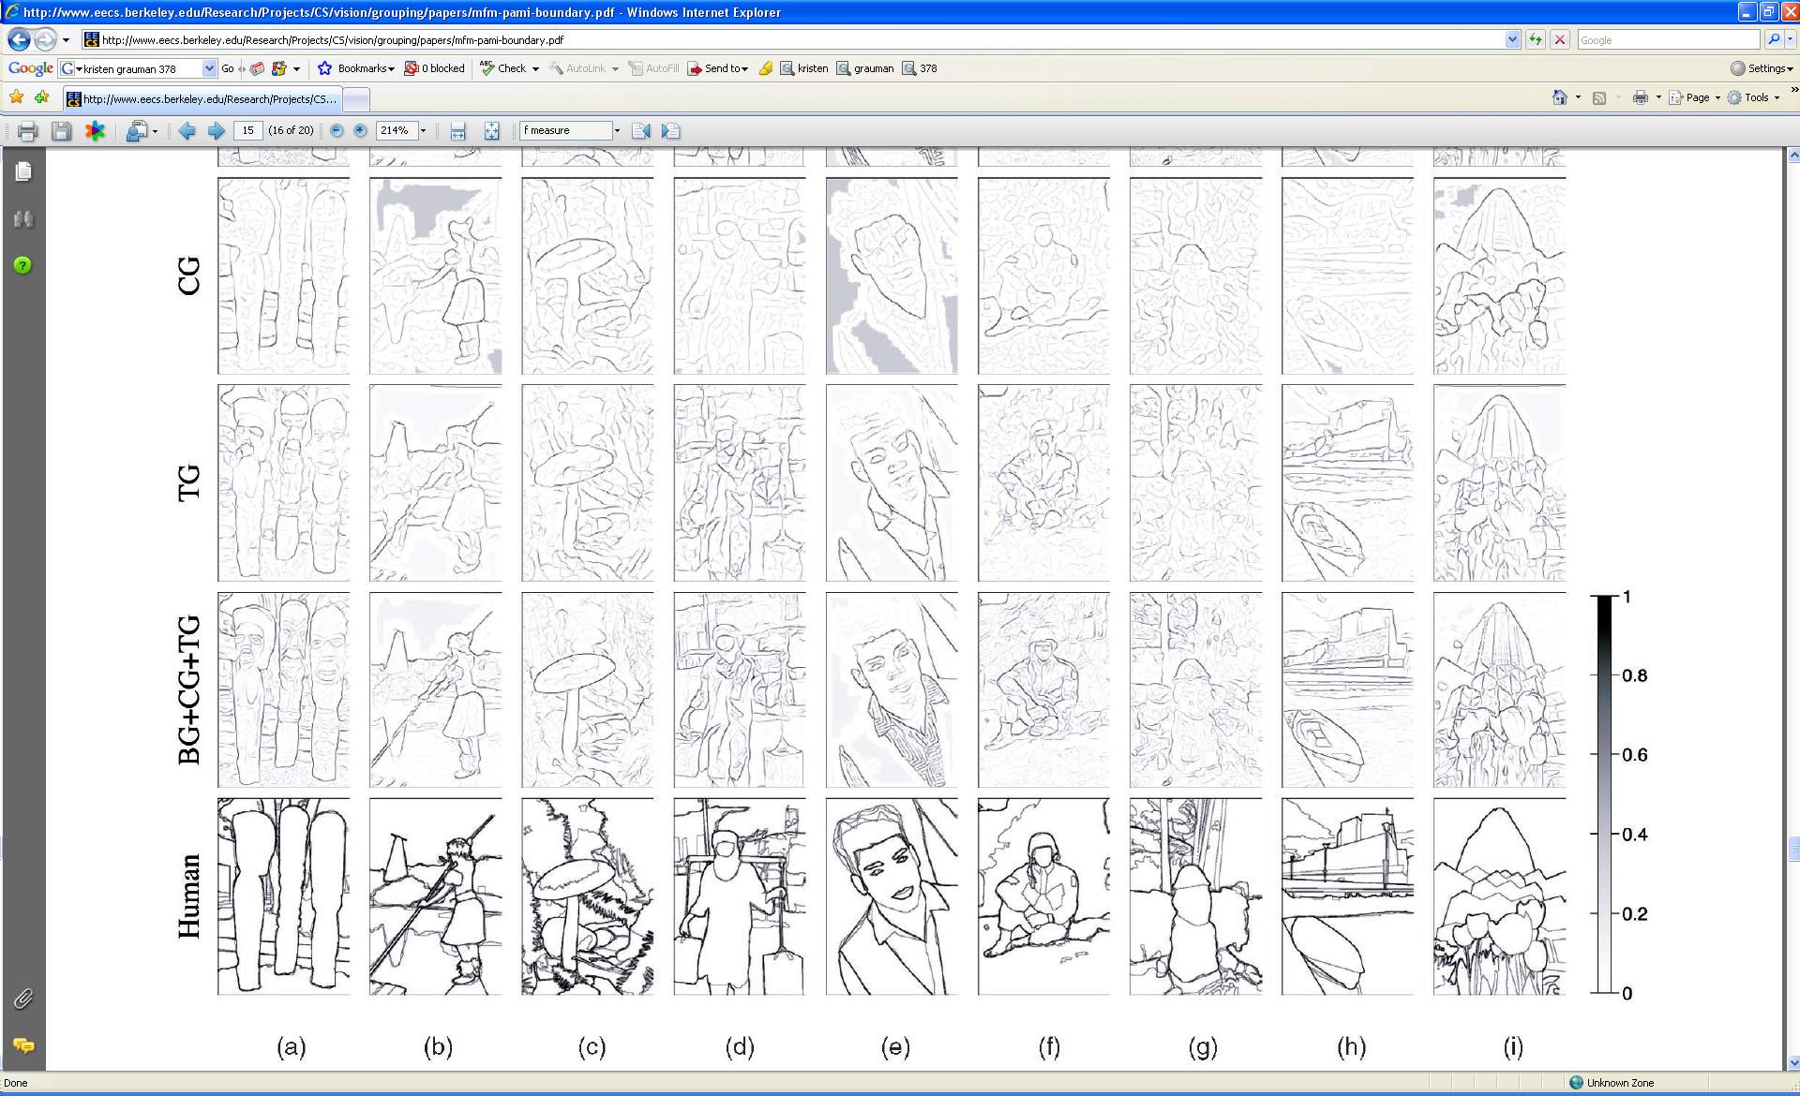
Slide credit: Kristen Grauman
[D. Martin et al. PAMI 2004]

Slide 53
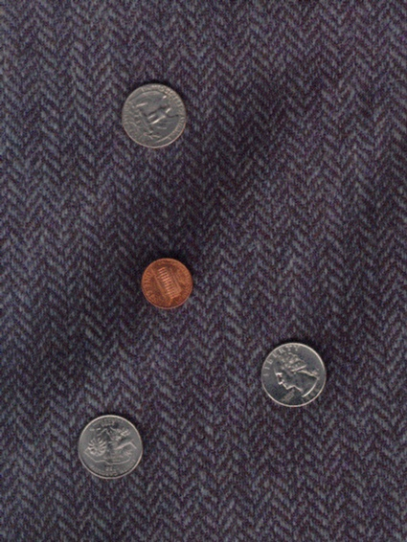
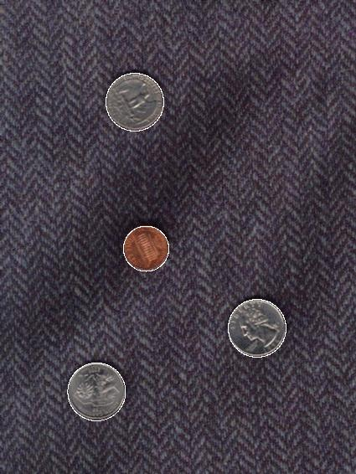
Voting and the Hough Transform
Disclaimer: Many slides have been borrowed from Devi Parikh and/or Kristen Grauman, who may have borrowed from others.
Slide credit: Kristen Grauman

Slide 54
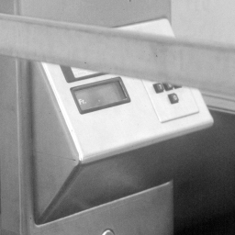
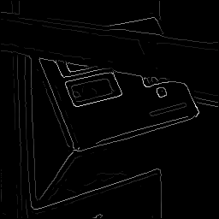
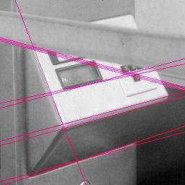


Fitting
Want to associate a model with observed features
[Fig from Marszalek & Schmid, 2007]
For example, the model could be a line, a circle, or an arbitrary shape.
Kristen Grauman

Slide 55
Fitting: Main idea
Choose a parametric model to represent a set of features
Membership criterion is not local
Can’t tell whether a point belongs to a given model just by looking at that point
Three main questions:
What model represents this set of features best?
Which of several model instances gets which feature?
How many model instances are there?
Computational complexity is important
It is infeasible to examine every possible set of parameters and every possible combination of features
Slide credit: L. Lazebnik

Slide 56



Example: Line fitting
Why fit lines?
Many objects characterized by presence of straight lines
Wait, why aren’t we done just by running edge detection?
Kristen Grauman

Slide 57

Difficulty of line fitting
Extra edge points (clutter), multiple models:
which points go with which line, if any?
Only some parts of each line detected, and some parts are missing:
how to find a line that bridges missing evidence?
Noise in measured edge points, orientations:
how to detect true underlying parameters?
Kristen Grauman

Slide 58
Voting
It’s not feasible to check all combinations of features by fitting a model to each possible subset.
Voting is a general technique where we let the features vote for all models that are compatible with it.
Cycle through features, cast votes for model parameters.
Look for model parameters that receive a lot of votes.
Noise & clutter features will cast votes too, but typically their votes should be inconsistent with the majority of “good” features.
Kristen Grauman

Slide 59
Fitting lines: Hough transform
Given points that belong to a line, what is the line?
How many lines are there?
Which points belong to which lines?
Hough Transform is a voting technique that can be used to answer all of these questions.
Main idea:
1. Record vote for each possible line on which each edge point lies.
2. Look for lines that get many votes.
Kristen Grauman

Slide 60

Finding lines in an image: Hough space
Equation of a line?
y = mx + b
y
b
b₀
x
m₀
m
image space
Hough (parameter) space
Connection image (x,y) and Hough (m,b) spaces:
Line in image corresponds to a point in Hough space
To go from image space to Hough space:
given a set of points (x,y), find all (m,b) such that y = mx + b
Slide credit: Steve Seitz

Slide 61

Finding lines in an image: Hough space
y
b
y₀
x₀
x
m
image space
Hough (parameter) space
Connection between image (x,y) and Hough (m,b) spaces
A line in the image corresponds to a point in Hough space
To go from image space to Hough space:
given a set of points (x,y), find all (m,b) such that y = mx + b
What does a point (x₀, y₀) in the image space map to?
Answer: the solutions of b = -x₀m + y₀
this is a line in Hough space
Slide credit: Steve Seitz

Slide 62
Finding lines in an image: Hough space
y
b
(x₁, y₁)
y₀
(x₀, y₀)
b = –x₁m + y₁
x₀
x
m
image space
Hough (parameter) space
What are the line parameters for the line that contains both (x₀, y₀) and (x₁, y₁)?
It is the intersection of the lines b = –x₀m + y₀ and b = –x₁m + y₁
Slide credit: Kristen Grauman

Slide 63
Finding lines in an image: Hough algorithm
y
b
x
m
image space
Hough (parameter) space
How can we use this to find the most likely parameters (m,b) for the most prominent line in the image space?
Let each edge point in image space vote for a set of possible parameters in Hough space
Accumulate votes in discrete set of bins; parameters with the most votes indicate line in image space.
Slide credit: Kristen Grauman

Slide 64
Polar representation for lines
Issues with usual (m,b) parameter space: can take on infinite values, undefined for vertical lines.
Image columns
[0,0]
: perpendicular distance from line to origin
: angle the perpendicular makes with the x-axis
Image rows
Point in image space → sinusoid segment in Hough space
Kristen Grauman

Slide 65


Original image
Canny edges
Vote space and top peaks
Kristen Grauman

Slide 66
Hough transform algorithm
Using the polar parameterization:
Basic Hough transform algorithm
Initialize H[d, θ]=0
for each edge point I[x, y] in the image
for θ = [θ_{min} to θ_{max} ] // some quantization
H[d, θ] += 1
Find the value(s) of (d, θ) where H[d, θ] is maximum
The detected line in the image is given by
H: accumulator array (votes)
d
θ
Source: Steve Seitz

Slide 67




Showing longest segments found
Kristen Grauman

Slide 68

Impact of noise on Hough
y
d
x
θ
Image space
edge coordinates
Votes
What difficulty does this present for an implementation?
Slide credit: Kristen Grauman

Slide 69

Impact of noise on Hough
Image space
edge coordinates
Votes
Here, everything appears to be “noise”, or random edge points, but we still see peaks in the vote space.
Slide credit: Kristen Grauman

Slide 70

Hough transform for circles
Circle: center (a,b) and radius r
Equation of circle?
For a fixed radius r
Equation of set of circles that all pass through a point?
Image space
Hough space
Adapted by Devi Parikh from: Kristen Grauman

Slide 71
Hough transform for circles
Circle: center (a,b) and radius r
For a fixed radius r
Intersection: most votes for center occur here.
Image space
Hough space
Kristen Grauman

Slide 72
Hough transform for circles
Circle: center (a,b) and radius r
For an unknown radius r
r
?
b
a
Image space
Hough space
Kristen Grauman

Slide 73

Hough transform for circles
Circle: center (a,b) and radius r
For an unknown radius r
r
b
a
Image space
Hough space
Kristen Grauman

Slide 74

Hough transform for circles
Circle: center (a,b) and radius r
For an unknown radius r, known gradient direction
x
θ
Image space
Hough space
Kristen Grauman

Slide 75
Hough transform for circles
For every edge pixel (x,y) :
For each possible radius value r:
For each possible gradient direction θ:
// or use estimated gradient at (x,y)
a = x – r cos(θ) // column
b = y + r sin(θ) // row
H[a,b,r] += 1
end
end
Kristen Grauman

Slide 76


Example: detecting circles with Hough
Original
Edges
Votes: Penny
Note: a different Hough transform (with separate accumulators) was used for each circle radius (quarters vs. penny).
Slide credit: Kristen Grauman

Slide 77
Example: detecting circles with Hough
Combined detections
Edges
Votes: Quarter
Slide credit: Kristen Grauman
Coin finding sample images from: Vivek Kwatra

Slide 78




Example: iris detection
Gradient+threshold
Hough space (fixed radius)
Max detections
Hemerson Pistori and Eduardo Rocha Costa http://rsbweb.nih.gov/ij/plugins/hough-circles.html
Kristen Grauman

Slide 79


Example: iris detection
An Iris Detection Method Using the Hough Transform and Its Evaluation for Facial and Eye Movement, by Hideki Kashima, Hitoshi Hongo, Kunihito Kato, Kazuhiko Yamamoto, ACCV 2002.
Kristen Grauman

Slide 80

Hough Voting for Object recognition

Slide 81

Hough Voting for Object recognition

Slide 82

Hough Voting for Object recognition

Slide 83
Hough transform: pros and cons
Pros
All points are processed independently, so can cope with occlusion, gaps
Some robustness to noise: noise points unlikely to contribute consistently to any single bin
Can detect multiple instances of a model in a single pass
Cons
Complexity of search time increases exponentially with the number of model parameters
Non-target shapes can produce spurious peaks in parameter space
Quantization: can be tricky to pick a good grid size
Kristen Grauman

Slide 84


ICCV 2019
Or Litany

Slide 85

Or Litany

